Slide 1
RTL

Slide 2
DCT
9
13
11
11
255~-256
DRU
1023~-1024
DRU
10
13
12
11
511~-512
acf、bdeg
2047~-2048
acf、bdeg
11
11
13
9
1023~-1024
IDRU
IDRU,output
4095~-4096
11
11
1023~-1024
transpose
The real range of IDRU output is 2047~-2048

Slide 3
IDCT
12
10
14
8
2047~-2048
DRU
8191~-8092
DRU
13
10
15
7
2047~-2048
acf、bdeg
8191~-8192
acf、bdeg
14
8
16
6
4095~-4096
IDRU
16381~-16382
IDRU
14
8
16
6
8191~-8192
transpose
32763~-32764
output
The real range of IDRU output is 255~-256

Slide 4
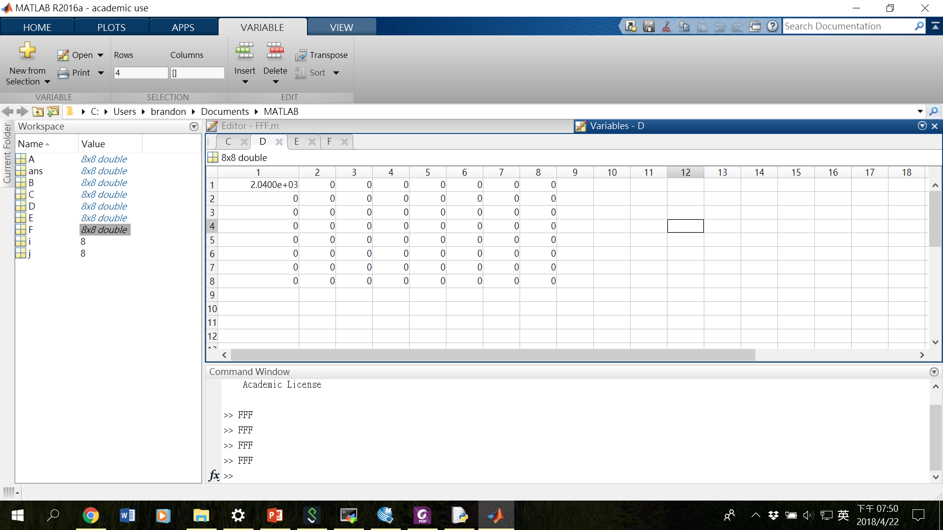
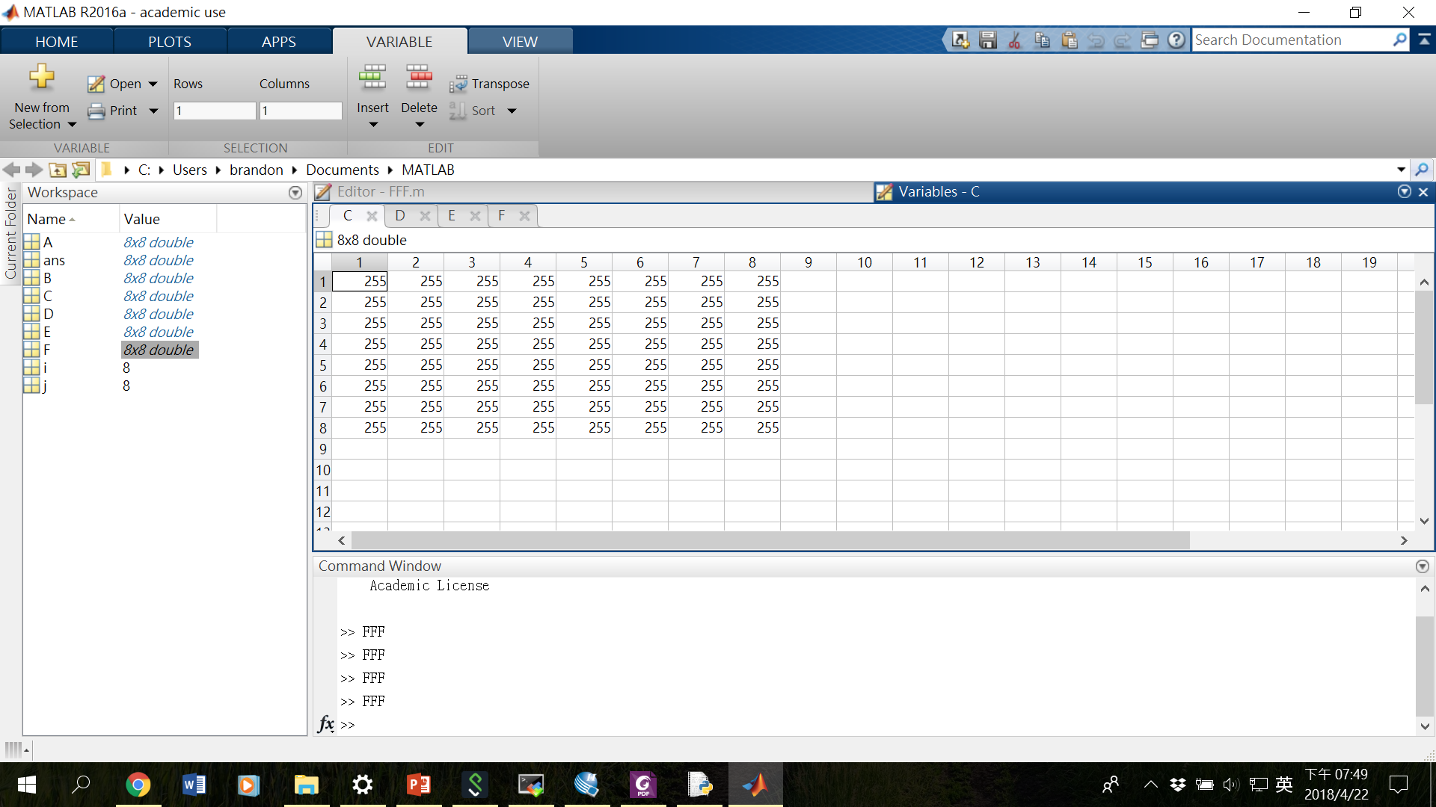
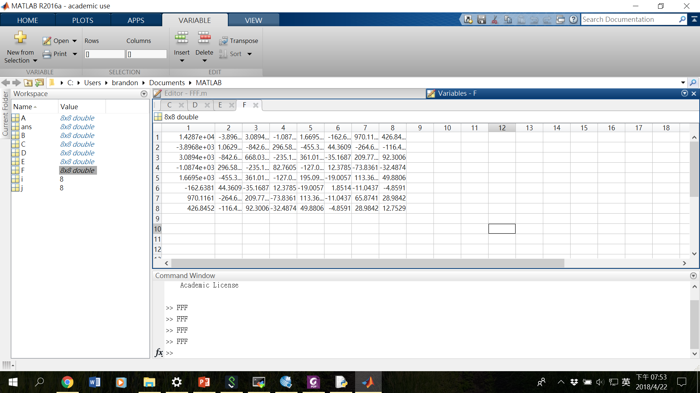
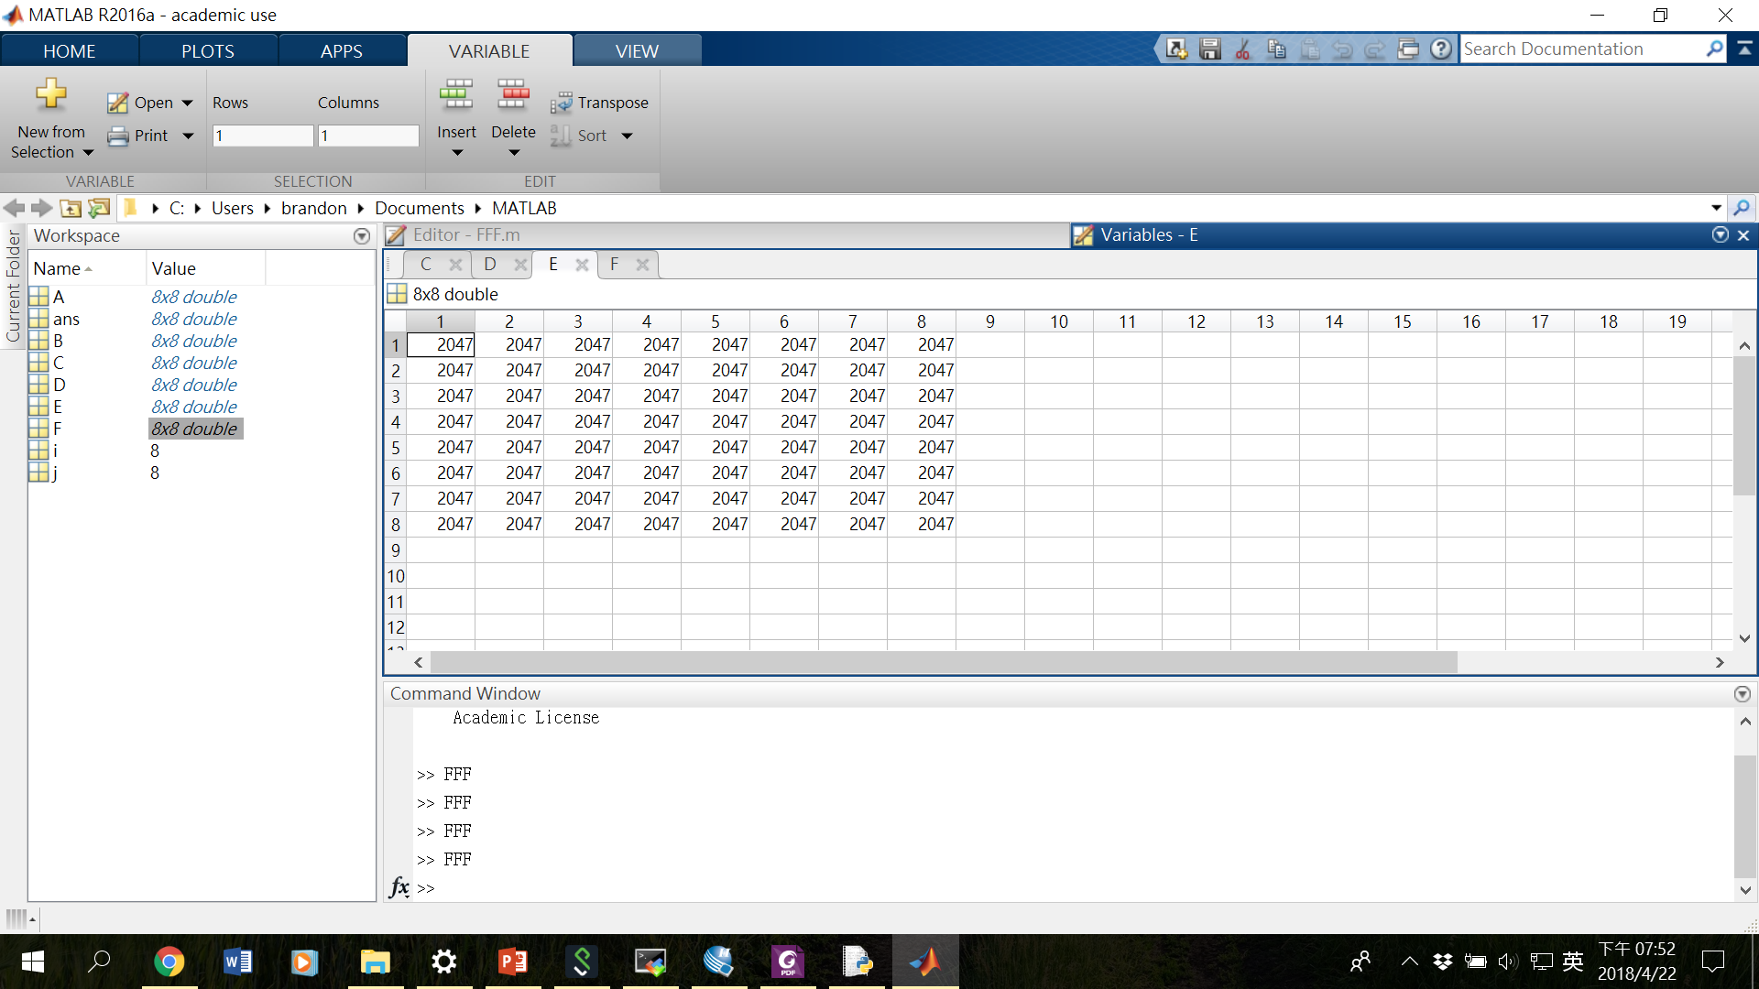
How many digits do we need in each stage?
DCT
IDCT

Slide 5
Simple testbench
Test if the result matrix after DCT and inverse DCT is the original input.
IDCT(DCT(X))==X?
The input matrix X is:
0 | 8 | 16 | 24 | 32 | 40 | 48 | 56
1 | 9 | 17 | 25 | 33 | 41 | 49 | 57
2 | 10 | 18 | 26 | 34 | 42 | 50 | 58
3 | 11 | 19 | 27 | 35 | 43 | 51 | 59
4 | 12 | 20 | 28 | 36 | 44 | 52 | 60
5 | 13 | 21 | 29 | 37 | 45 | 53 | 61
6 | 14 | 22 | 30 | 38 | 46 | 54 | 62
7 | 15 | 23 | 31 | 39 | 47 | 55 | 63

Slide 6
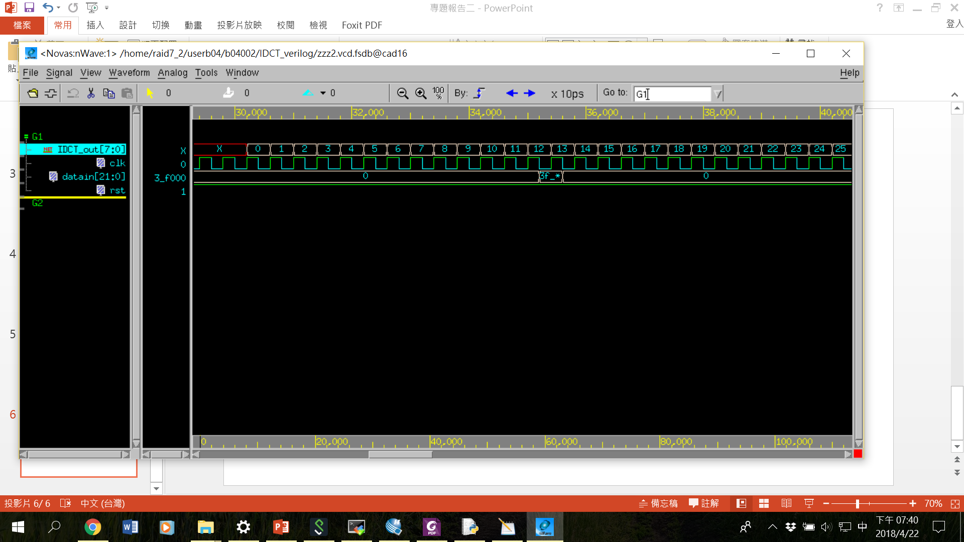
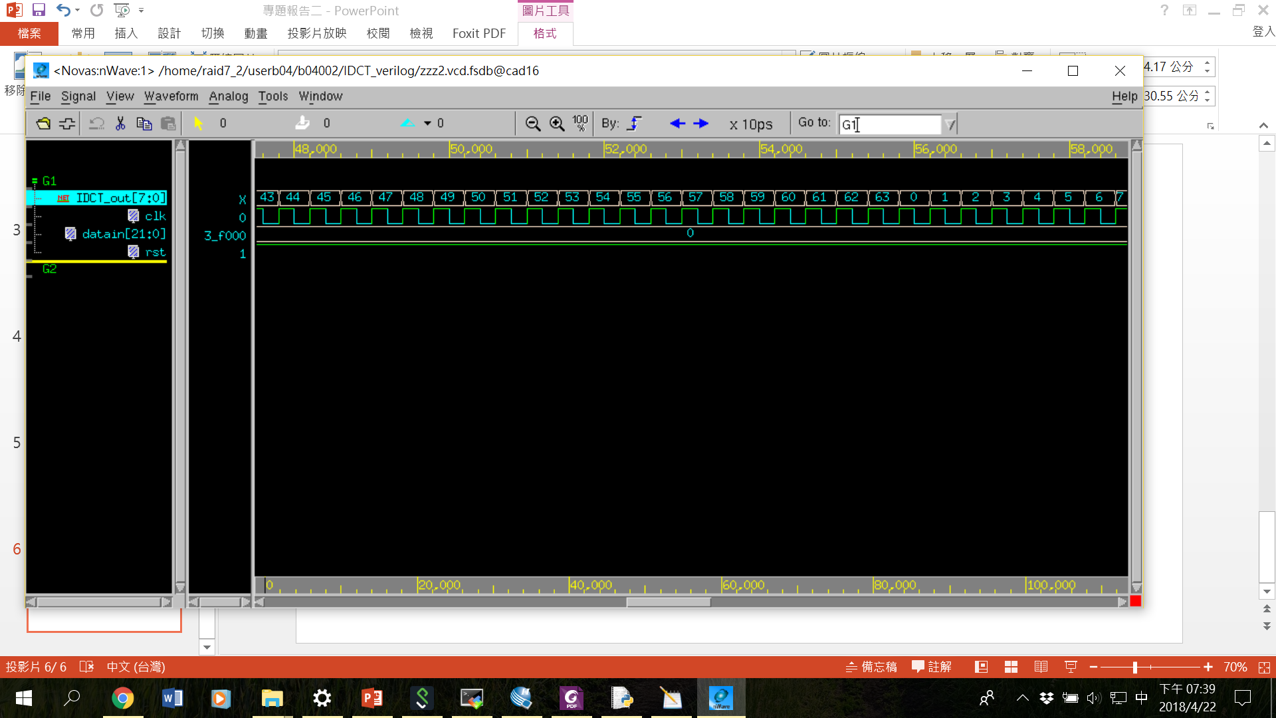
Result
Latency=69 clk
Through put 1/clk
I learned that improper truncation handling will cause great error!!

Slide 7
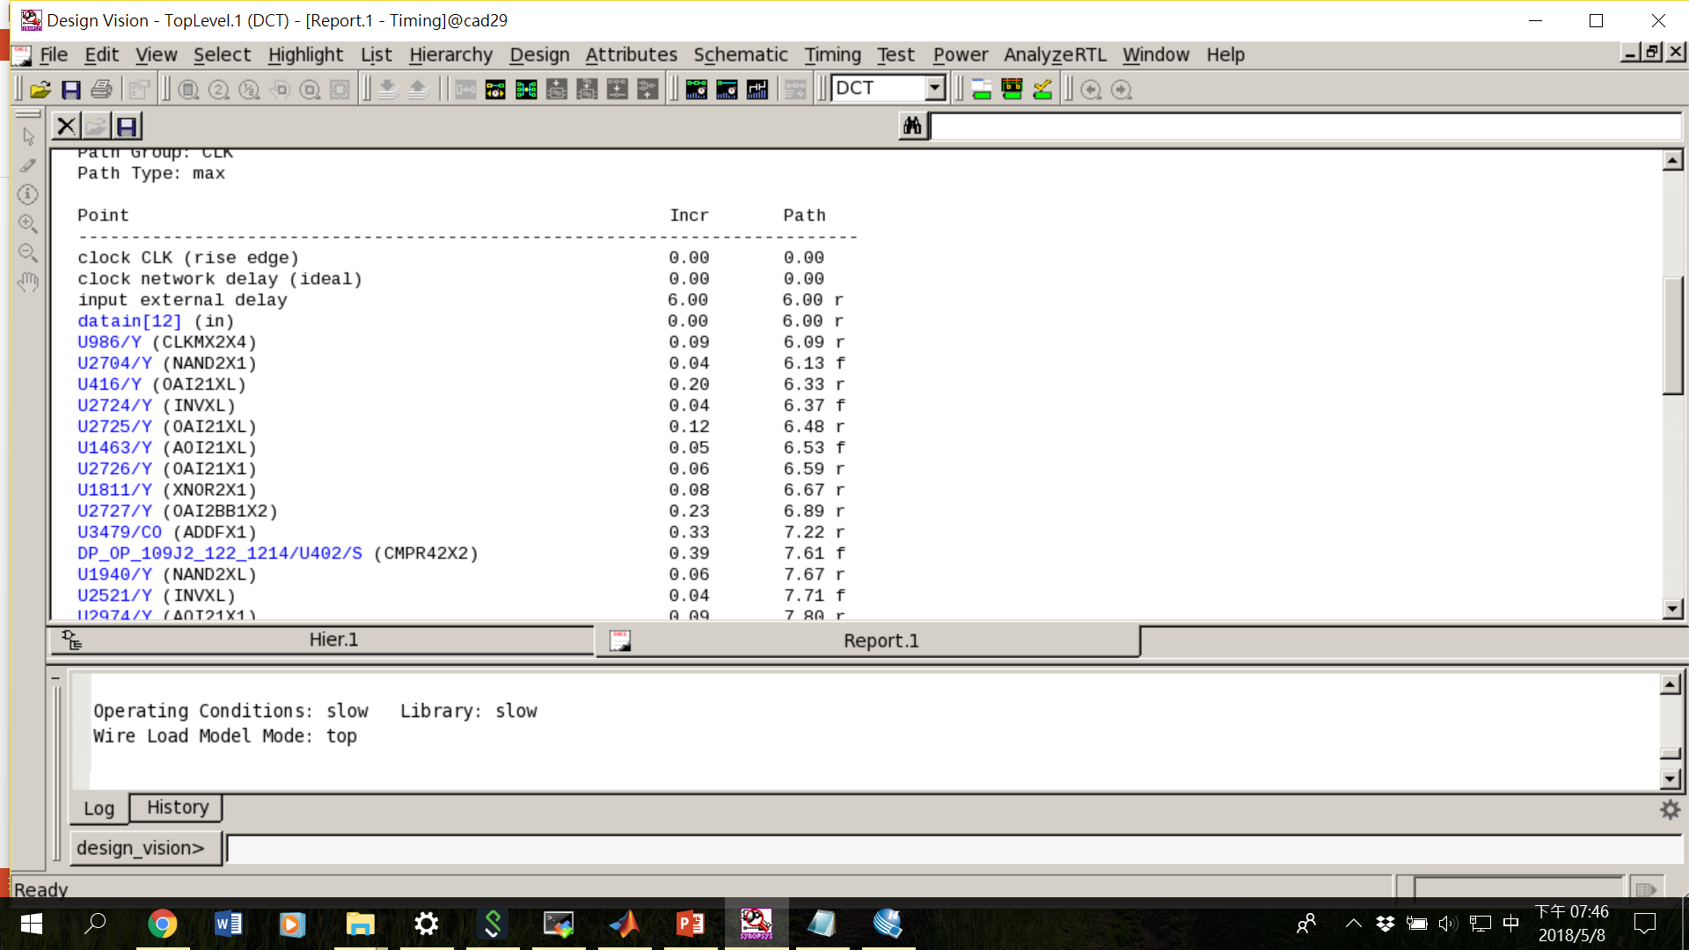
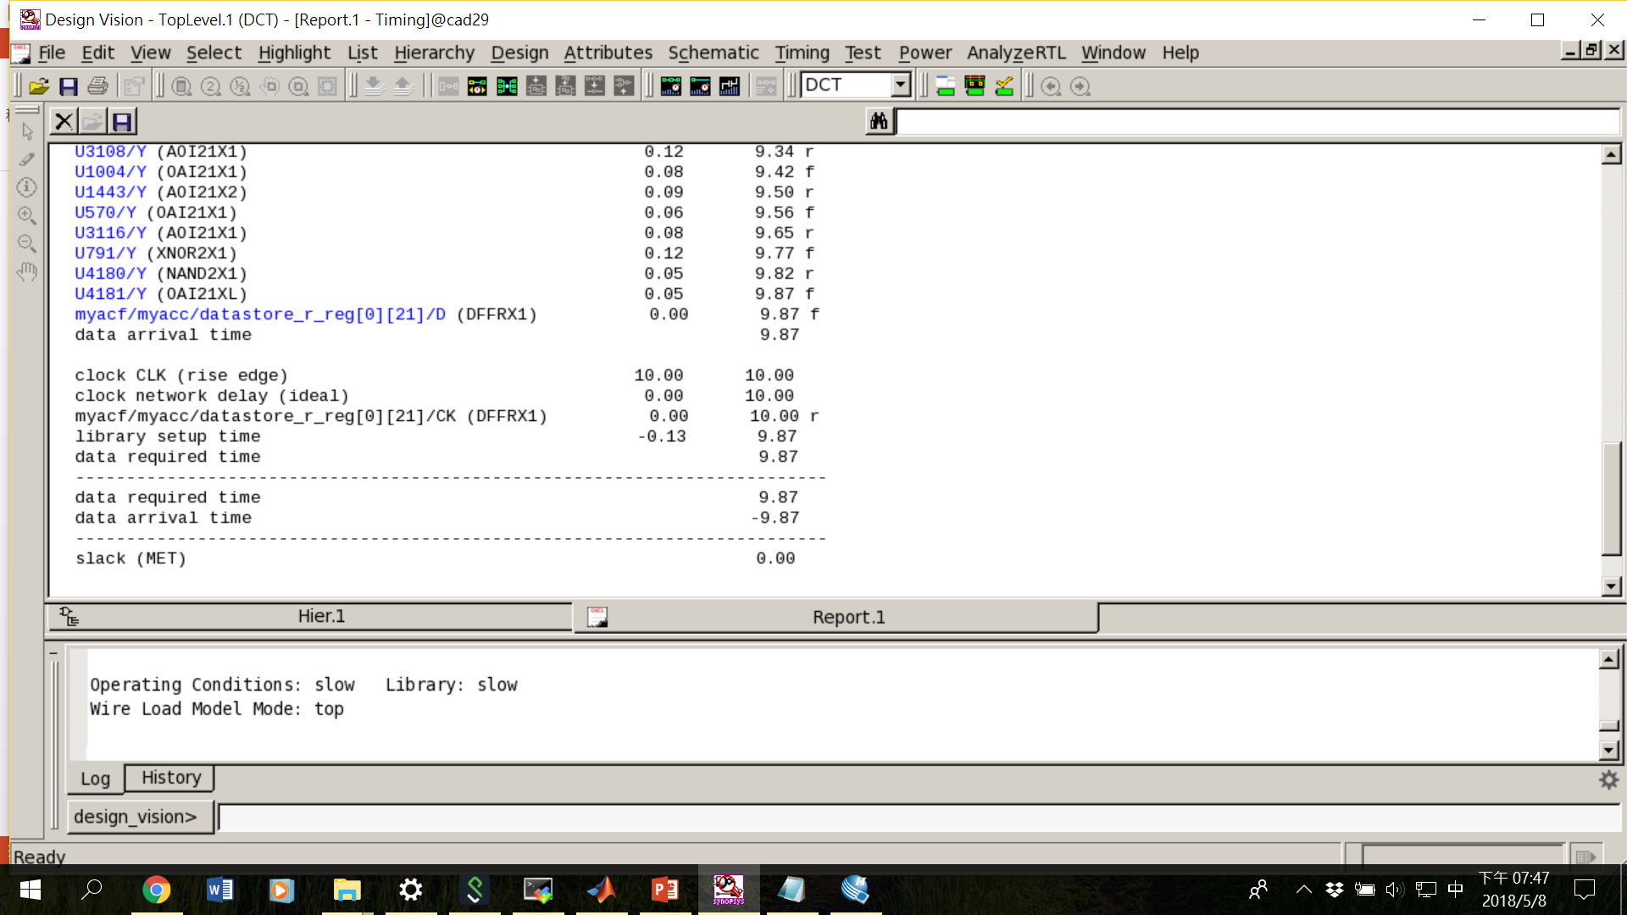
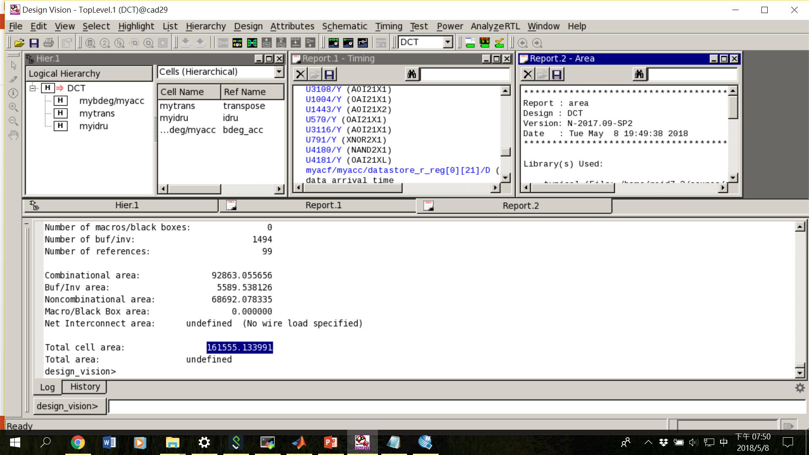
Input delay is set to 6ns
Clock cycle set to 10 ns

Slide 8
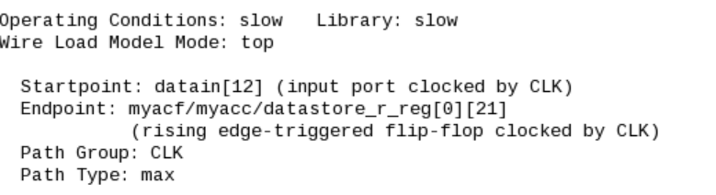
TODOs
The same finite state machine is declared multiple times in different modules.
Transpose mem could use shift register instead of MUX. This could further reduce the area.
More pipeline

Slide 9
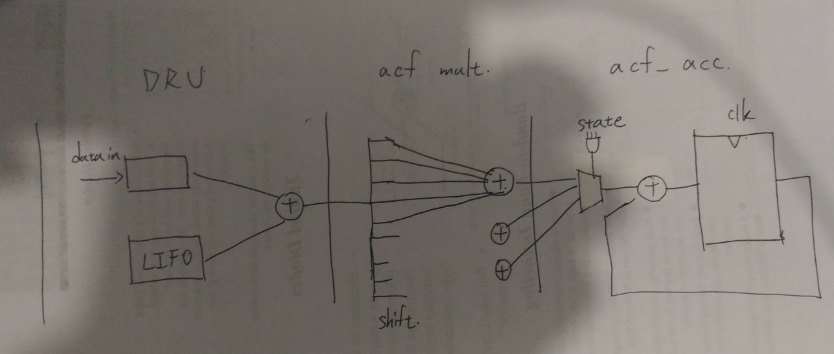
Current critical path

